Slide 1
Philosophy
Attempts to achieve a wide perspective on life.
We study history and philosophy to try to find out what man is.

Slide 2
Philosophers study ethics
They don’t tell is what is right and wrong
They show us how to think about what is right and wrong

Slide 3
Our Basic Nature Challenges Civilization every Day
Today The family has been weakened
Religion has been weakened
Our educational system is discouraged by
class and race war
Public opinion loses force through division, fear, apathy, and universal worship of wealth
Even sex seems to be in chaos

Slide 4
Achievements
Cell phone
Computer
Medical advances
Immunization
Travel
Abundant food

Slide 5
The problems
Global climate change
Pollution
Social inequality
Environmental degradation

Slide 6
Agricultural problems
Production
Pesticide resistance
Loss of biodiversity
Invasive species
Biotech/GMOs
Sustainability

Slide 7
Progress and Growth
The good things of life
The future will be
Bigger, Better, Easier, Faster
We can’t keep up

Slide 8
We humans, Earth’s dominant species, are not just figures in the landscape we are shapers of the landscape.
We need to think carefully about what we are shaping. We need to think about what we do and undo.

Slide 9
How do you know what to do in agriculture and in life?
How do you know what you choose to do is the right thing to do?

Slide 10
How do we decide what to do?
Norman Borlaug
Green Revolution
Moral Challenges
Why? Cost

Slide 11
Quality of Science
Based on regular delivery of technological innovations
Which have increased food production and kept food cost low
BUT
Externalities
What could (what has) go wrong?

Slide 13
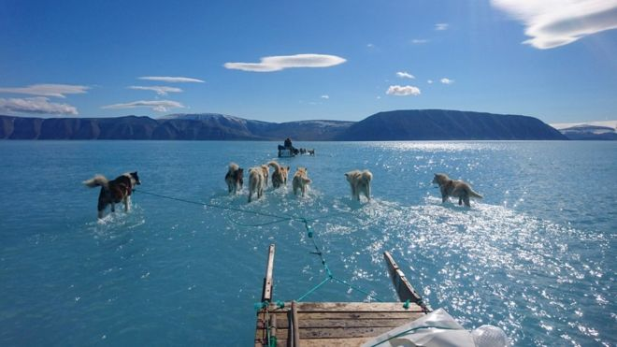
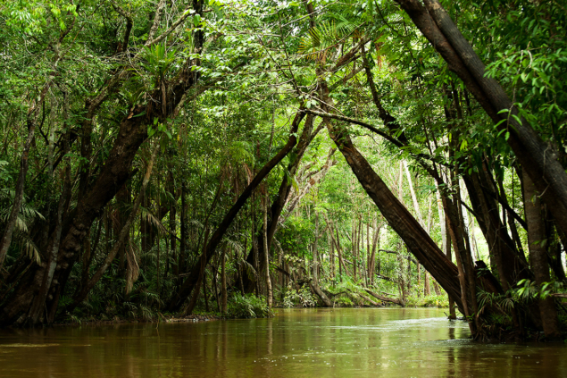
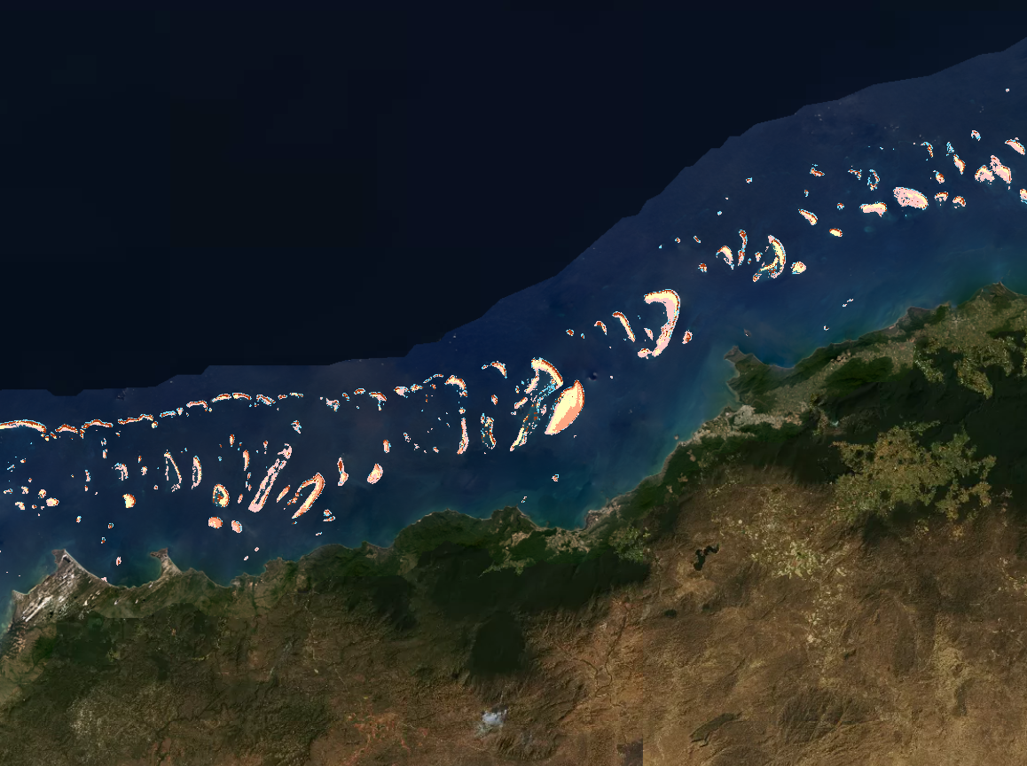
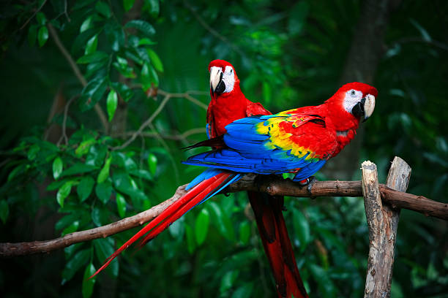
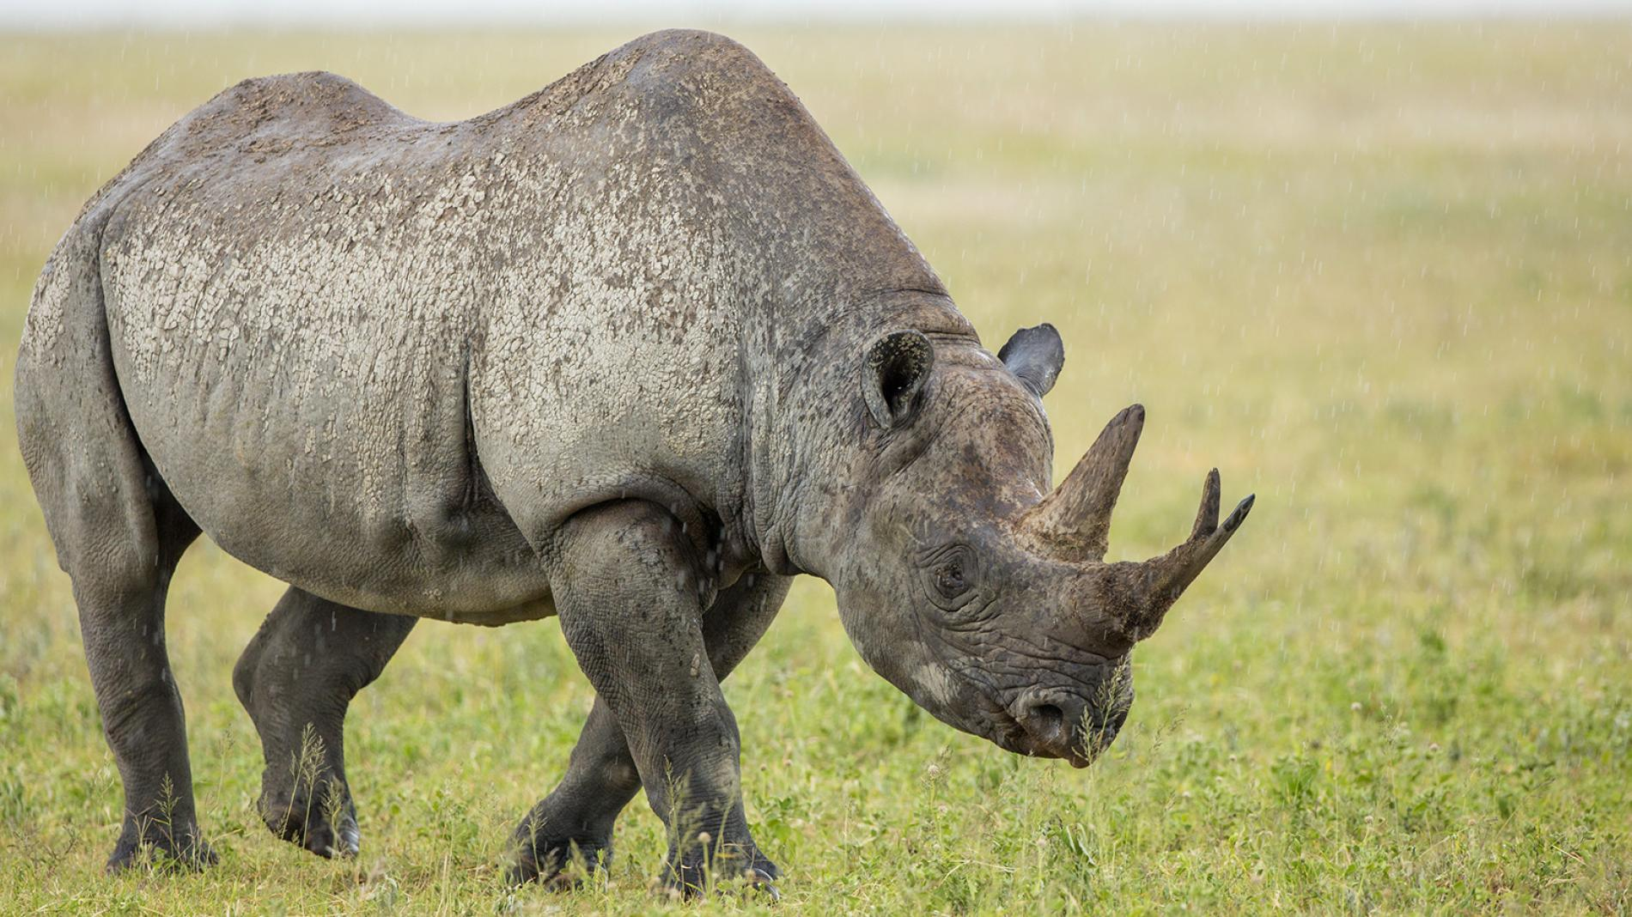
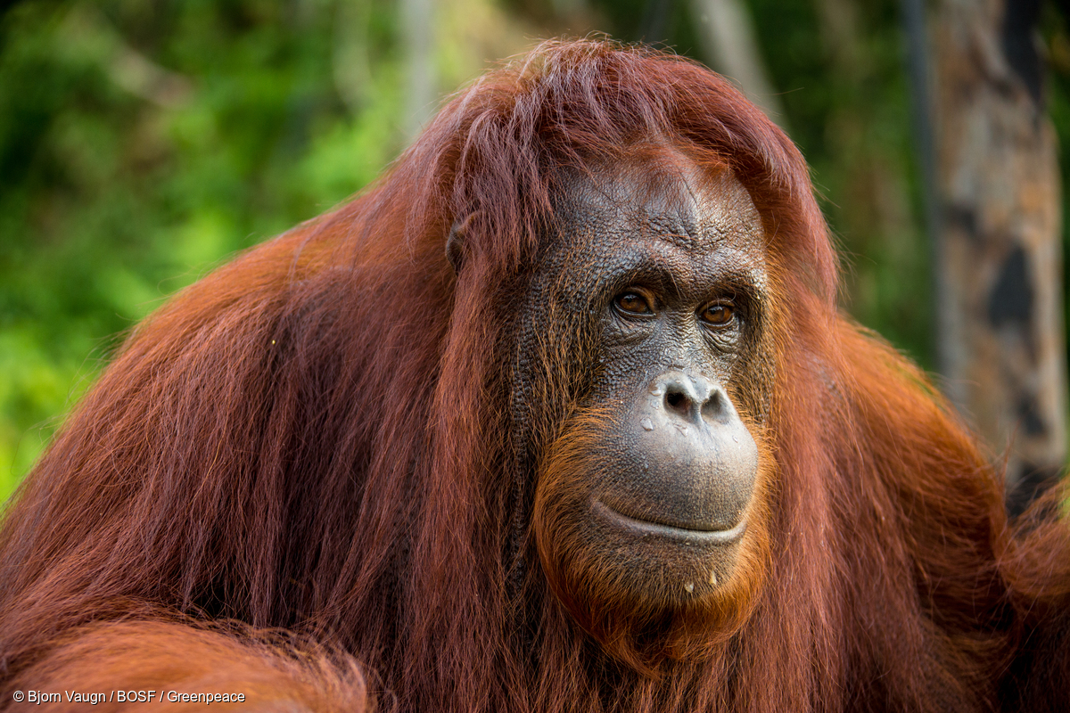
The Dominant Species
Greenland ice sheet
Amazon rain forest
Great barrier reef and Koalas
Macaws
Rhinos
Orangutan

Slide 14
Concerns About Agriculture
Sustainability
Land
Re-thinking
Water
Limits?

Slide 15
Concerns About Agriculture
Pesticides
80% used in agriculture – 40% are herbicides
Dangerous, overused, pollute
Herbicides dominate research

Slide 16
Concerns About Agriculture
Antibiotics
Biodiversity
Losing 0.01 to 0.1%/ year
Biotechnology and GMOs
Technological progress
Nature

Slide 17
Concerns About Agriculture
Davidson - University of Florida
With publication of R. Carson’s Silent Spring the agricultural community loudly and in unison said pesticides do not contaminate the environment. Now we admit they do. We said that nitrates from fertilizer could not reach groundwater in excess of 10 ppm. We now admit they do. We claimed that if pesticides were used in accordance with label directions, agricultural products would be free of pesticides. We now admit they are not.
Public illiteracy

Slide 18
Concerns About Agriculture
The environment
Are these just fringe concerns?
If they are societal
concerns
Agriculture has an
ethical dilemma

Slide 19
Is production a
sufficient criterion?
Does it justify
everything?

Slide 22
Growth Per Day
228,000
3,167

Slide 23
What is the problem?
Is it food production?
Of course it is!
But
Distribution/infrastructure
Waste
Poverty

Slide 24
Risks
Dialog
Listening and
understanding
First we listen.
Then we learn.
Then we help.
Only then can we lead

Slide 25
Ethics for agriculture
Agriculture – the essential human activity.
Must have a firm
ethical foundation
It’s not just
about results

Slide 26
Responsibilities
Sustainability
Agricultural
labor
Water
Pollution
Harm
Habitat
Diversity
Farms
Agri-
Business
Animals
GMOs
Nutrition

Slide 27
Ethical Questions
Research and teaching
A view of the future we expect, desire, or fear
What is the right thing to do?

Slide 28
What Can Universities Do
Few classes
Only 9 US university Colleges of Agriculture offer a class on the ethics of agriculture
In 1999 there were 15
Why?

Slide 29
How do you know what to do in agriculture and in life?
How do you know what you choose to do is the right thing to do?

Slide 30
